Slide 1

Working with HDFS

Slide 2

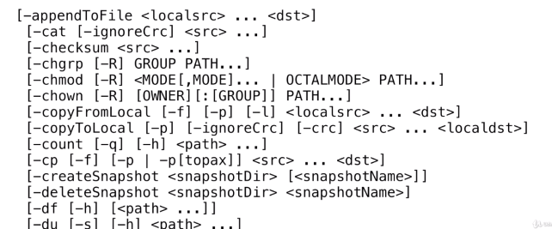
HDFS Commands
First point to understand in Command Line Interface
Hadoop fs
Hadoop dfs
fs command is used when the file system is not HDFS
dfs command is used when the file system is HDFS
$hdfs dfs
$hadoop fs

Slide 3
HDFS Commands
Making a Directory
$hadoop fs -mkdir /test
General form is to precede with Hadoop fs
Creates a directory at the top level of the file system

Slide 4
HDFS Commands
Content opportunity
$hadoop fs -ls /test
ls prints the list of all the files in the directoryc

Slide 5
HDFS Commands
Content of a file
$hadoop fs –cat <file name>
Cat is used to see the contents of a file

Slide 6
HDFS Commands
Change the ownership of a file
$hadoop fs –chown <newowner><filepath>
Chown is used to change the ownership for a file

Slide 7
HDFS Commands
HDFS Commands to transfer file across file systems
$hadoop fs –copyFromLocal <localFilepath> <hdfspath>
Put can be used instead of copyFromLocal

Slide 8
HDFS Commands
HDFS Commands to transfer file across file systems
$hadoop fs –copyToLocal <hdfs path> <Localfilepath>
copyToLocal to transfer files from hdfs to local file path
Get can be used instead of copyToLocal

Slide 9
HDFS Commands
Explore the other commnads
$hadoop fs –help
Many more useful commands, help will print
Documentation for all of them

Slide 10
HDFS Commands
Deleting the files and directories
$hadoop rm <filepath>
$hadoop rm –r filename

Slide 11
Parallelism in Map and Reduce Phase

Slide 12
Combiner Functions

Slide 13
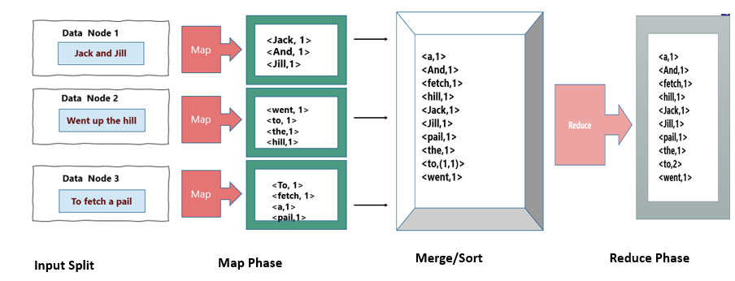
HDFS
Parallelize the Reduce Phase-Combiner Function

Slide 14
HDFS
Parallelize the Reduce Phase-Combiner Function
Reduce operation currently no parallelization
All data to one sort/merger and reduce it to one
Map operation is highly parallelized

Slide 15
HDFS
What is Combiner Function?
After Map before passing to merge/sort, it is passed to the combiner.
Combiner combines the key-value pairs with same key before they are copied over for reduce.
Data Node 1
<Twinkle,1>
<Twinkle,1>
<Little,1>
<Star,1>
<Twinkle,2>
<Little,1>
<Star,1>
Twinkle Twinkle little star
Map
Combiner

Slide 16
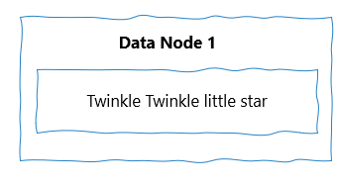
HDFS
Combiner Function
<Twinkle,2>
<Little,1>
<Star,1>
Map/Combine
Part of reduce is done in the datanode itself using the combiner function.
Combined the data to speed up the reduce phase.
Kind of front loaded the reduce operation by using the combine.

Slide 17
Implementing a combiner in Map Reduce

Slide 18
HDFS
Implementation
Step 1 : Write a Map ( ) Function
Step 1a : Write a Combiner ( ) Function
Step 2: Write a Reduce Function
Step 3: Setup a driver that points to your Map and reduce implementations

Slide 19
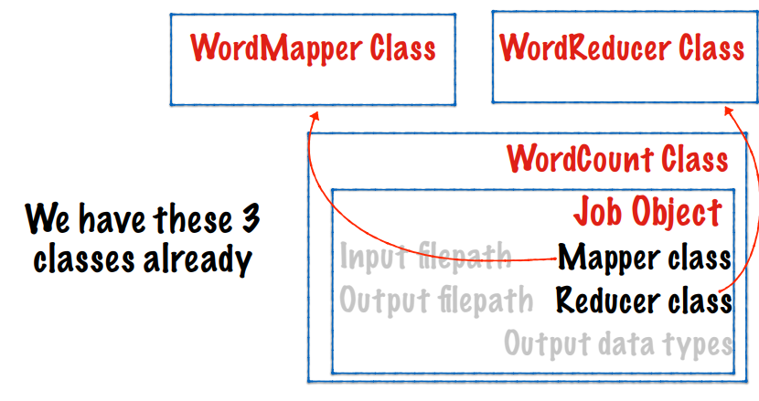
HDFS
Implementation

Slide 20
HDFS
Implementation of Combiner function
The combiner function is implemented by extending the reducer class
We will simply point the combiner class in Job to Wordreducer
In other words the Wordreducer can act as the combiner as well
We don’t need to change the wordmapper and wordreducer class

Slide 21
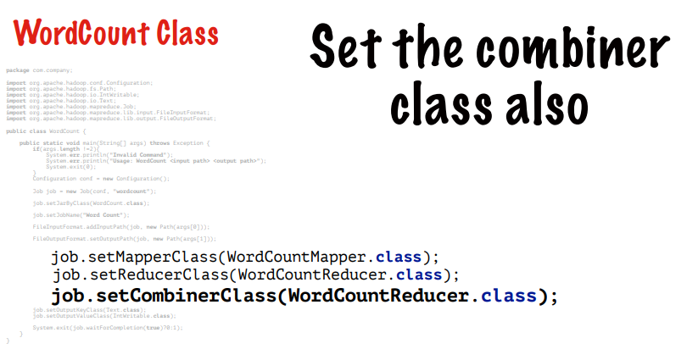
HDFS
Implementation of Combiner function

Slide 22
Constraints on the Combiner Function

Slide 23
HDFS
Constraints on the combiner function
It makes the Map/Reduce task run faster, however
Reduce operation is partially parallelized
Less data needs to be transferred across the network

Slide 24
HDFS
Constraints on the combiner function-Example
A file contains 3 columns Players, Runs Scored, Match
Compute the batting average of each player
Can we use average( ) as the combiner function?

Slide 25
THANK YOU
“WORLD IS ONE BIG DATA PROBLEM”
“TORTURE THE DATA AND IT WILL CONFESS TO ANYTHING”

